Slide 1


AI/ML Hackathon 2026
Build. Solve. Present.
2-Day AI/ML Hackathon for Engineering Students

Slide 2
Team Details.
Team Name
InsightLoops
Team Lead
Our Team Lead is Bhavish Kumar
Havyas B
Shamanth N P
Kishan B P
Team Members

Slide 3
Problem.
PROBLEM STATEMENT
Monitoring student engagement in online and hybrid classrooms is challenging, especially at scale. Traditional methods are subjective and ineffective in identifying disengaged students early, leading to poor academic outcomes. This project proposes an image-based machine learning solution to automatically detect and classify student engagement levels.

Slide 4
Proofs for Problem Statement.
Student engagement data is complex and often misleading. Metrics alone cannot capture true learning and may raise ethical concerns, requiring a more balanced approach.
Link to News Article 1
ML enables automatic engagement detection using behavioral and visual data, improving accuracy through deep learning.
Link to News Article 2
Machine learning can accurately predict student engagement, enabling early identification of disengaged students and improving overall learning outcomes.
Link to News Article 3

Slide 5
Solve.
Our Solution
To design/develop a machine learning-based engagement detection system online and hybrid classrooms that solves the problem of monitoring student attention.

Slide 6
Tech Stack .
This Model
automatically detects and classifies student engagement from the uploaded image..
ML /AI Engine
Backend and API
This is our Backend
Because it can efficiently process images and perform real-time engagement classification, we use Flask for API development, and CNN with TensorFlow and Keras for the backend.

Slide 7
Tech Stack .
Frontend and Dashboard
Infrastructure
Our Frontend is built using HTML, CSS, and JavaScript.
CPU/GPU servers, Web Interface.

Slide 8
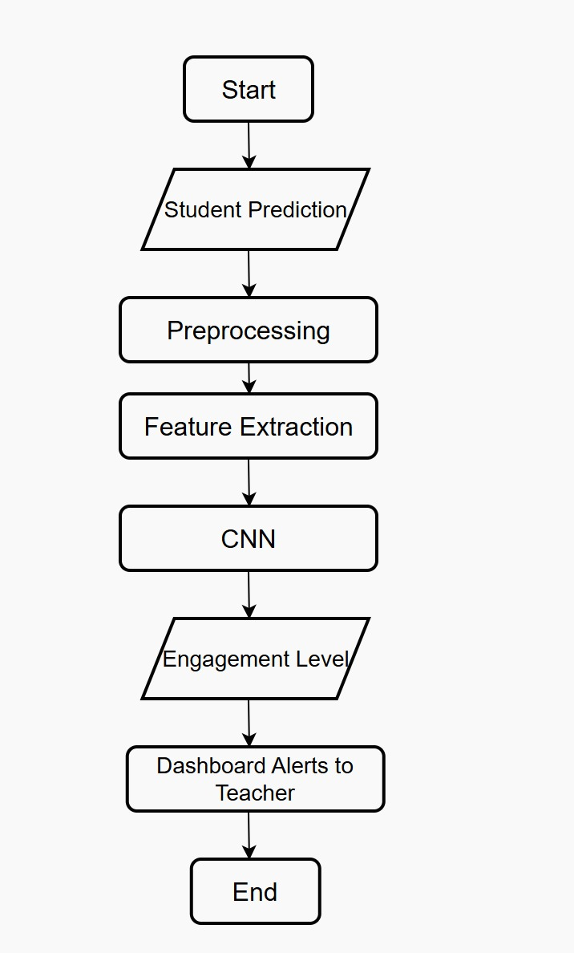
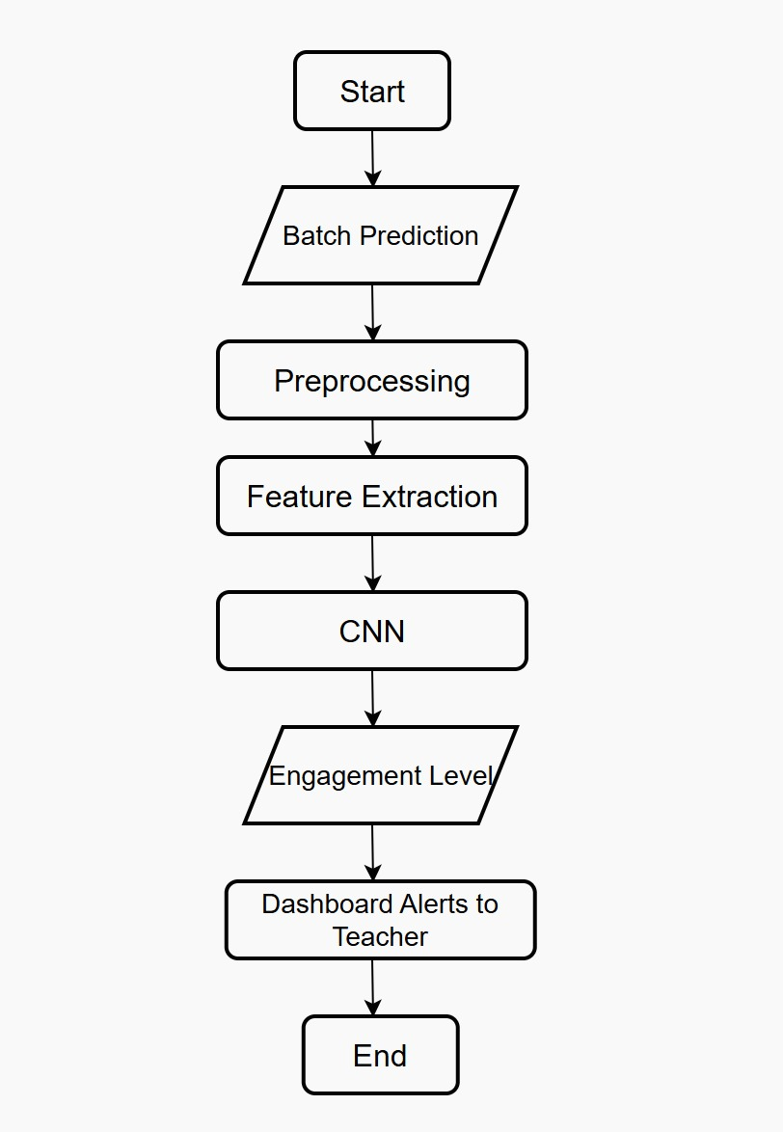
Solution Flow .
Stakeholder Perspective 1
Stakeholder Perspective 2

Slide 9
Expected Outcome .
Accuracy
95%
Sends alert in
30 Seconds
Other Parameter
Estimatted Score

Slide 10
Actual Outcome .
Accuracy
85%
Sends alert in
30 Seconds
Other Parameter
Estimatted Score

Slide 11
Impact .
Reduces time from
8 Hours
to
10 Minutes
Reduces time from
8 Hours
to
10 Minutes
Reduces time from
8 Hours
to
10 Minutes

